Slide 1
TECHNICAL DEBT ISN’T TECHNICAL
@EINARWH

Slide 2


Slide 3
WHAT IS TECHNICAL DEBT?

Slide 4
TECHNICAL DEBT AS A MEME

Slide 5


Slide 6
MEMETICS

Slide 7
SELF-REPLICATING UNIT OF THOUGHT

Slide 8
COPIED FROM BRAIN TO BRAIN

Slide 9
VIRUS OF THE MIND

Slide 10
WHAT MAKES A MEME SUCCESSFUL?

Slide 11
SURVIVAL OF THE FITTEST?

Slide 12
GREATEST EXPLANATION POWER?

Slide 13
MOST EFFECTIVE AT REDUCING COGNITIVE DISSONANCE?

Slide 14
THE BEST IDEAS
VS
THE IDEAS THAT MAKE US FEEL BEST

Slide 15
WHAT IS TECHNICAL DEBT?

Slide 16
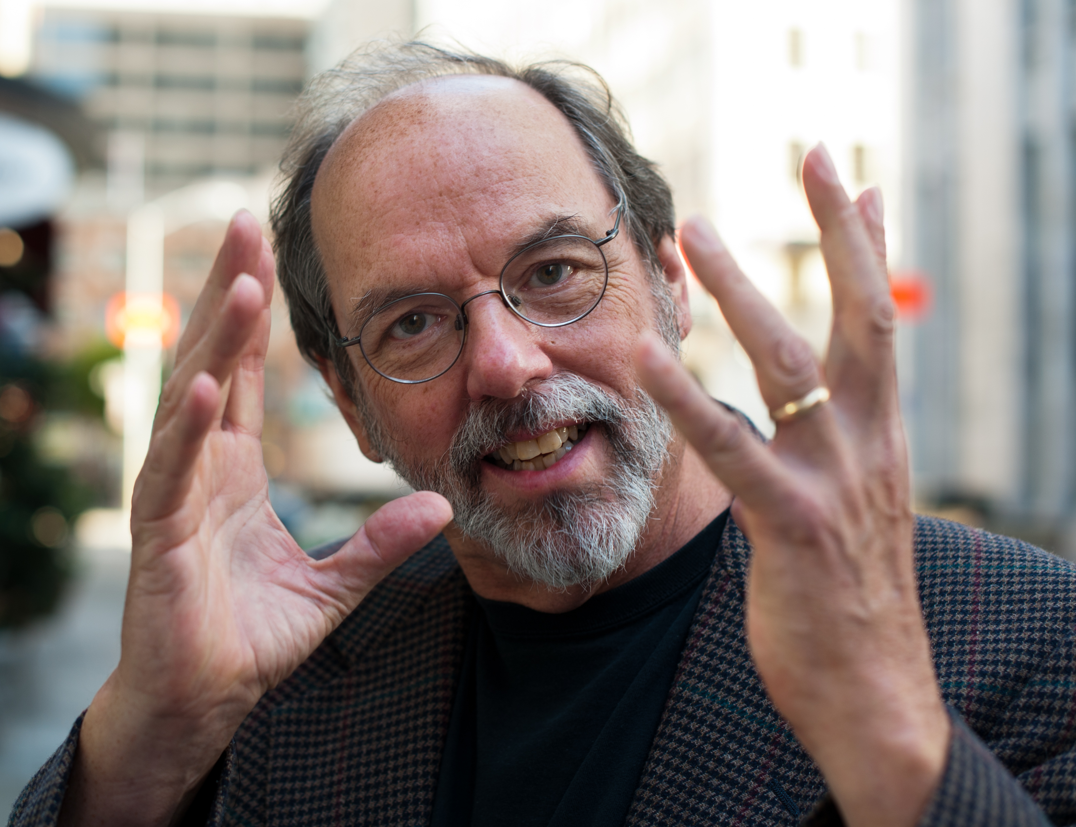

Slide 17
SHIPPING FIRST TIME CODE IS LIKE GOING INTO DEBT. A little debt speeds development so long as it is paid back promptly with a rewrite... The danger occurs when the debt is not repaid. Every minute spent on not-quite-right code counts as interest on that debt. Entire engineering organizations can be brought to a stand-still under the debt load of an unconsolidated implementation.

Slide 18
WHAT MAKES TECHNICAL DEBT A GOOD METAPHOR?

Slide 19
GIVES US LANGUAGE TO TALK ABOUT SOMETHING IMPORTANT!

Slide 20
PUTS QUALITY ON THE AGENDA!

Slide 21
MAKES THE INVISIBLE VISIBLE!

Slide 22
THANK YOU WARD CUNNINGHAM!

Slide 23
WHAT MAKES TECHNICAL DEBT A PROBLEMATIC METAPHOR?

Slide 24
MONETARY DEBT IS QUANTIFIED

Slide 25
HOW MEASURABLE IS TECHNICAL DEBT?

Slide 26
HOW BIG IS OUR TECHNICAL DEBT?

Slide 27
ARE WE TECHNICALLY SOLVENT?

Slide 28
CAN WE GO TECHNICALLY BANKRUPT???

Slide 29
WHAT IS TECHNICAL DEBT REALLY?

Slide 30
WHAT DOES TECHNICAL DEBT LOOK LIKE?

Slide 31
”UGLY CODE”?

Slide 32
WHAT CAUSES TECHNICAL DEBT?

Slide 33
WHAT MAKES THE CODE UGLY?

Slide 34
LACK OF TIME?

Slide 35
MY PROJECT MANAGER DOESN’T UNDERSTAND ME?

Slide 36
THE UX PEOPLE ARE UNREALISTIC DREAMERS?

Slide 37
THE PREVIOUS DEVELOPER WAS INCOMPETENT?

Slide 38
WHAT DOES TECHNICAL DEBT LOOK LIKE?

Slide 39
HEAPS OF FLAGS, BRANCHES AND INDIRECTIONS

Slide 40
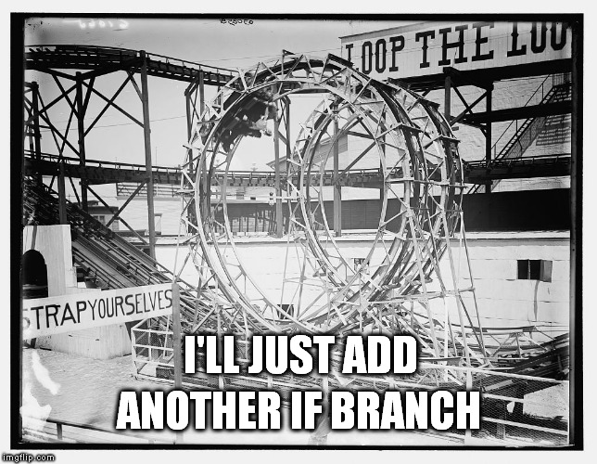

Slide 41
DIFFICULT TO DETERMINE WHERE ONE THING ENDS AND ANOTHER BEGINS

Slide 42
DIFFICULT TO ISOLATE CODE RELATED TO A SINGLE FEATURE

Slide 43
DIFFICULT TO PREDICT THE EFFECT OF CHANGES

Slide 44
DIFFICULT TO REASON ABOUT THE CODE

Slide 45
WHAT DOES THIS INDICATE?

Slide 46
THAT THE PRODUCT OWNER DOESN’T UNDERSTAND TECHNOLOGY?

Slide 47
THAT THE PREVIOUS DEVELOPER USED THE WRONG FRAMEWORK FOR DEPENDENCY INJECTION?

Slide 48
THAT WE SHOULD INTRODUCE MICRO SERVICES?

Slide 49
THAT WE NEED A NOSQL DATABASE?

Slide 50
THAT WE SHOULD GO SERVERLESS?

Slide 51
MOVE EVERYTHING TO KUBERNETES?

Slide 52
NO.

Slide 53
( THAT MUCH WAS OBVIOUS. )

Slide 54
BUT IT’S ALSO OBVIOUS THAT SOMETHING HAS GONE FUNDAMENTALLY WRONG

Slide 55
SOMETHING HAS GONE WRONG IN THE PROCESS OF
CAPTURING THE BUSINESS DOMAIN IN SOFTWARE

Slide 56
SOMETHING HAS GONE WRONG IN THE PROCESS OF
UNDERSTANDING THE BUSINESS DOMAIN

Slide 57
SOMETHING HAS GONE WRONG IN THE PROCESS OF
MAKING AND ENFORCING DECISIONS

Slide 58
SOMETHING HAS GONE WRONG IN THE PROCESS OF
FINDING A SUITABLE REPRESENTATION OF THE DOMAIN IN SOFTWARE

Slide 59
WE HAVE A WORD FOR THIS PROCESS

Slide 60
MODELLING

Slide 61
MODELLING HAS FAILED

Slide 62
WHAT IS THE NAME OF THE TOOL WE USE TO CONTAIN AND CONQUER COMPLEXITY?

Slide 63
ABSTRACTION

Slide 64
WHAT IS THE NAME OF THE TOOL WE USE TO CREATE AND COMPOUND COMPLEXITY?

Slide 65
ABSTRACTION

Slide 66
MODELLING IS APPLYING ABSTRACTION TO A PROBLEM DOMAIN

Slide 67
MODELLING IS DEFINING WHAT THE PROBLEM DOMAIN IS

Slide 68
WORKING CONTINOUSLY TO UNDERSTAND AND ARTICULATE THE PROBLEM TO SOLVE IS NOT BIG DESIGN UP FRONT

Slide 69
“You're wise to make the software reflect your understanding as best you can”

Slide 70
HOW CAN WE PAY OFF TECHNICAL DEBT?

Slide 71
( EVERYBODY NOW )

Slide 72
REFACTORING!

Slide 73

WHICH REFACTORING FIXES A TANGLED MESS OF WEAK ABSTRACTIONS?

Slide 74
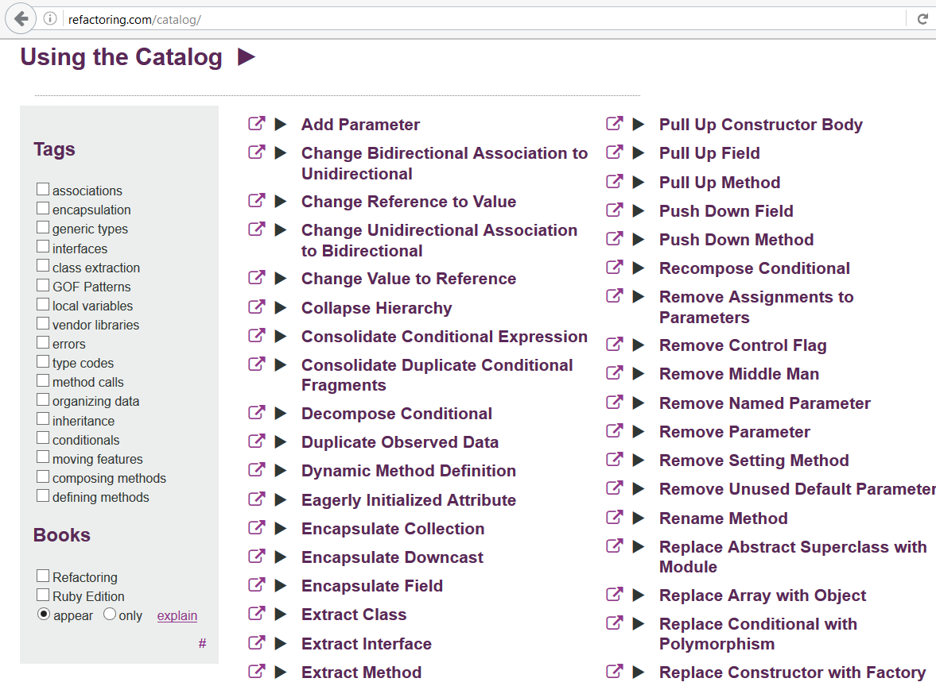

Slide 75
A rewrite will end up with the same problems as the original unless you close the understanding gap. — @sarahmei

Slide 76
NO REFACTORING WITHOUT REMODELLING

Slide 77
ANYTHING ELSE IS DEVELOPER HUBRIS

Slide 78

SOFTWARE CRAFTSMAN TO THE RESCUE

Slide 79
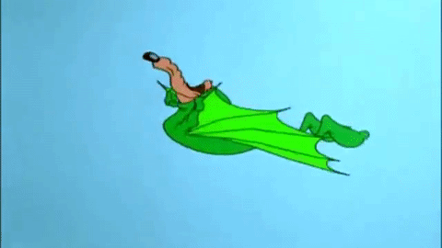

Slide 80
SO-CALLED BEST PRACTICES ARE NOT ENOUGH!

Slide 81
CLEAN CODE CAN NOT AND WILL NOT SAVE A ROTTEN MODEL!

Slide 82
YOU WILL WASTE TIME AND MONEY!

Slide 83
FIX THE MODEL FIRST THEN THE CODE

Slide 84
ARE WE DONE NOW?

Slide 85
HOW DO WE FIX THE MODEL?

Slide 86
WHAT CAUSES MODELLING DEBT?

Slide 87
( OMG HERE WE GO AGAIN! )

Slide 88
THE STORY OF EQUEST

Slide 89
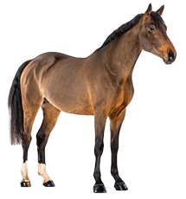
A HORSE

Slide 90
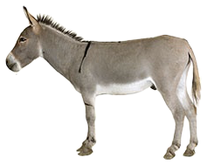
A NEW HORSE

Slide 91
A SHORT, STRONG AND STUBBORN HORSE

Slide 92
A HORSE?

Slide 93
A HORSE?

Slide 94
A HORSE?
+

Slide 95
A REGULAR HORSE

Slide 96
A TYPICAL HORSE

Slide 97
A TRUE HORSE

Slide 98
AN OLD-FASHIONED HORSE

Slide 99
A HORSE-HORSE

Slide 100
if (horse.IsShort && horse.IsStubborn) {
// Logic for the new horse case.
}
else
{
// Regular horse code here.
}

Slide 101
BUGS!

Slide 102
if (horse.IsShort &&
horse.IsStubborn &&
horse.Sound == Sound.HeeHaw)
{
// Logic for the new horse case.
}
else
{
// Regular horse code here.
}

Slide 103
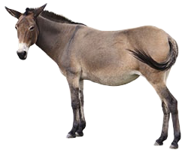
A NEW NEW HORSE

Slide 104
THE KIND OF HORSE THAT IS THE OFFSPRING OF A REGULAR HORSE-HORSE
AND A SHORT AND STUBBORN HORSE THAT GOES HEE-HAW

Slide 105
if (horse.IsShort &&
horse.IsStubborn &&
horse.Sound == Sound.HeeHaw) ||
(horse.Sire.IsShort &&
horse.Sire.IsStubborn &&
horse.Sire.Sound == Sound.HeeHaw) ||
(horse.Dam.IsShort &&
horse.Dam.IsStubborn &&
horse.Dam.Sound == Sound.HeeHaw))
{
// Logic for both the new horse
// and the new-new horse!
} else
{
// Really regular horse code here.
}

Slide 106
BUGS!

Slide 107
IS IT THE MOTHER
OR THE FATHER
THAT IS STUBBORN AND STRONG AND GOES HEE-HAW?

Slide 108


Slide 109
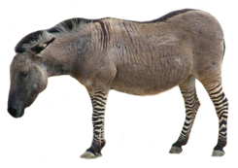
A NEW NEW NEW HORSE

Slide 110


Slide 111
RECOMMENDED READING WHAT, IF ANYTHING, IS A ZEBRA? SJ GOULD

Slide 112
GIBT ES LEPORIDEN?
↓
WHAT, IF ANYTHING, IS A RABBIT?
↓ WHAT, IF ANYTHING, IS A ZEBRA?
↑ STRIPES DO NOT A ZEBRA MAKE

Slide 113
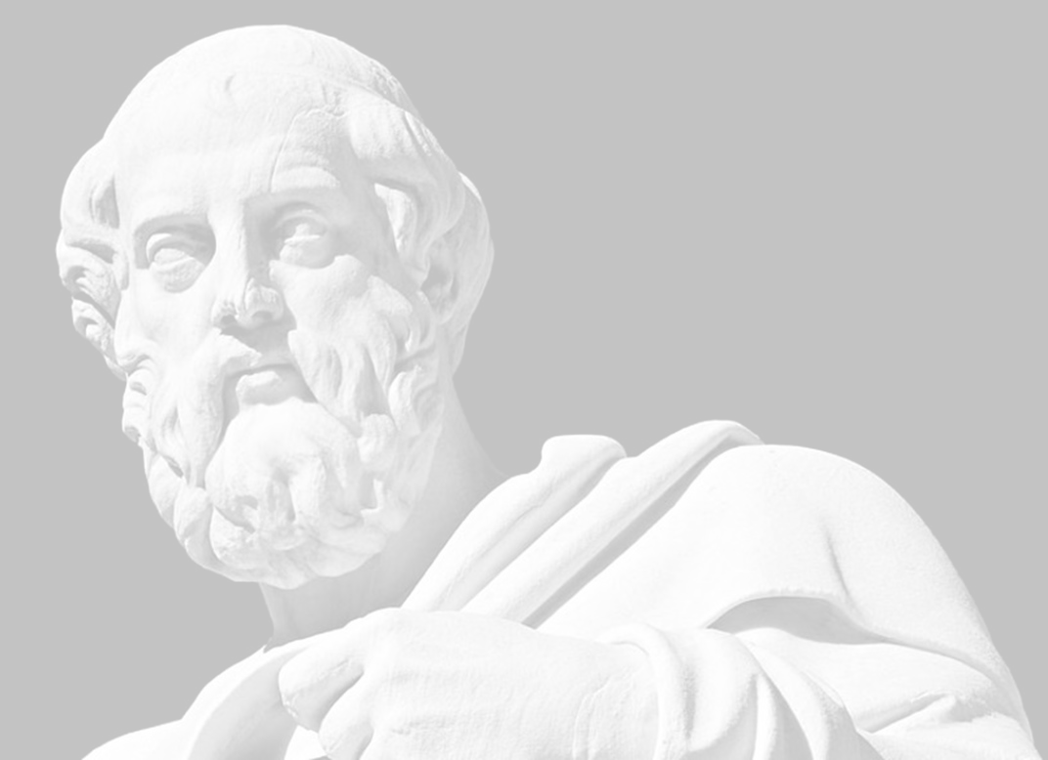
THERE IS NO TRUTH TO BE UNCOVERED

Slide 114
THERE ARE MORE OR LESS USEFUL MODELS

Slide 115
MODELLING IS AS MUCH ABOUT DEFINING AS DISCOVERING

Slide 116
THE STORY OF NRK TV

Slide 117
WHAT, IF ANYTHING, IS A TV SHOW?

Slide 118

A TV SHOW

Slide 119

ANOTHER TV SHOW

Slide 120

YET ANOTHER TV SHOW

Slide 121

AND YET ANOTHER TV SHOW

Slide 122
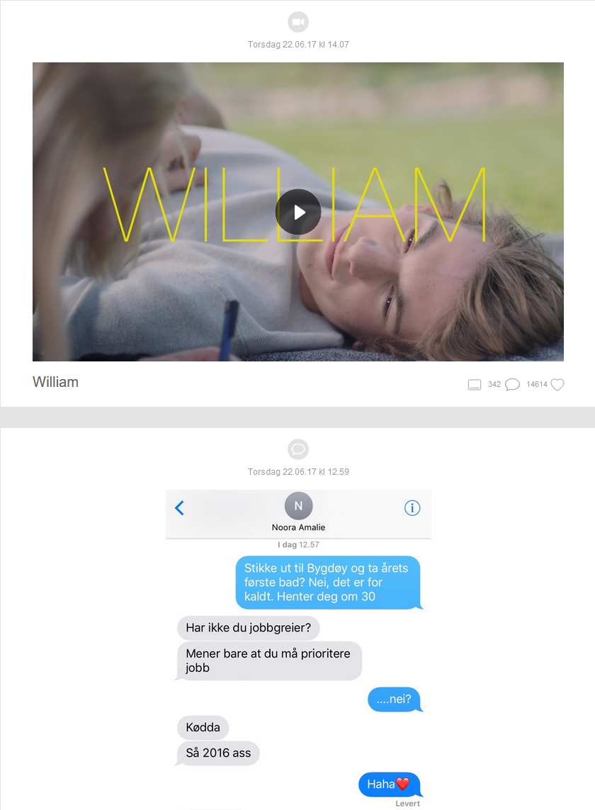
A TV SHOW?

Slide 123
HOW MANY KINDS OF TV SHOWS ARE THERE?

Slide 124
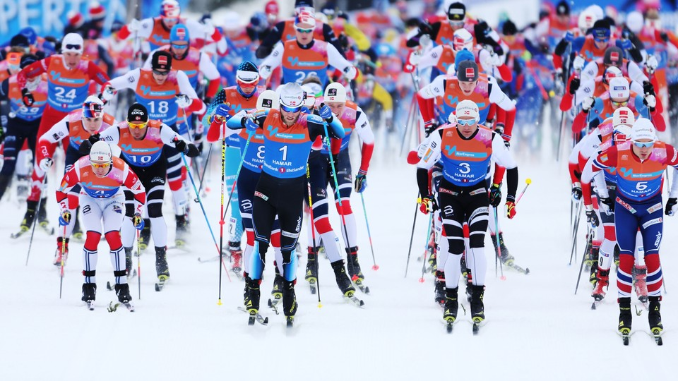

Slide 125
WHICH CONCEPTS SHOULD WE USE?

Slide 126
HOW CAN WE ENABLE OURSELVES TO TALK PRECISELY?

Slide 127
WHAT DO WE WANT TO EXPRESS?

Slide 128
LIVE EVENTS

Slide 129
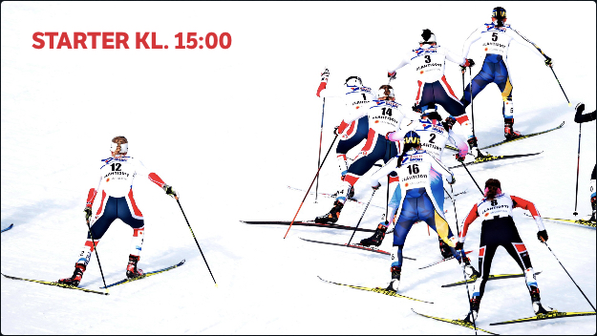
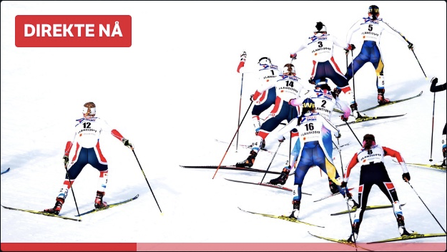
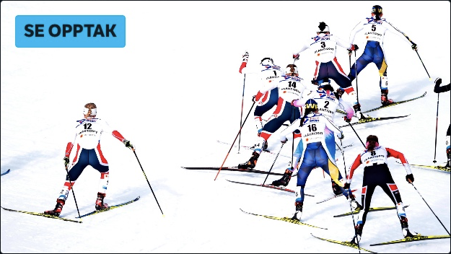
14:45
PLANNED
15:30
LIVE
17:00
AFTER

Slide 130
LIVE BROADCAST

Slide 131
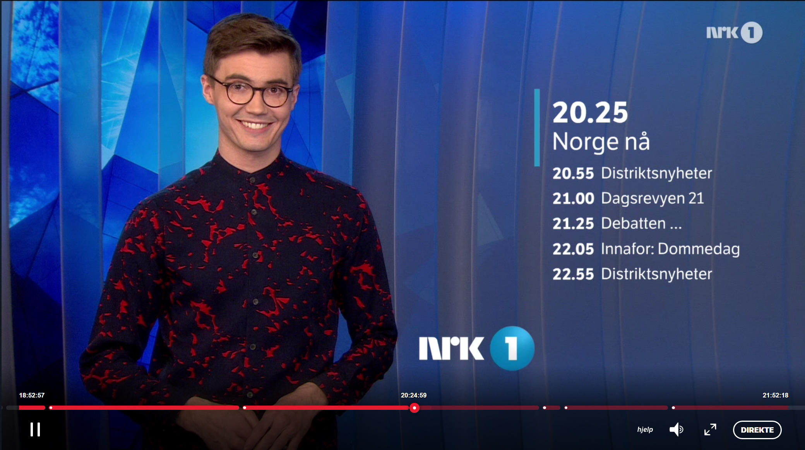

Slide 132
SO TO SUMMARIZE…

Slide 133
YOU CAN WATCH LIVE ON DEMAND

Slide 134
YOU CAN WATCH ON DEMAND LIVE

Slide 135
YOU CAN WATCH LIVE LIVE

Slide 136
LANGUAGE IS TERRIBLE!

Slide 137
MODELLING IS HARD!

Slide 138
MODELLING IS HARD FOR TWO REASONS

Slide 139
#1
THE STUFF THAT IS MODELLED

Slide 140
#2
THOSE DOING THE MODELLING

Slide 141
WHY MODELLING IS HARD
#1
THE STUFF THAT IS MODELLED

Slide 142
REALITY HAS NO INTEREST IN BEING MODELLED

Slide 143
REALITY IS NOT TIDY AND ORGANIZED

Slide 144
REALITY IS NOT EVEN CONSISTENT

Slide 145
REALITY IS MESSY AND ORGANIC, SLIPS AWAY AND EVOLVES

Slide 146
WE ARE TRYING TO IMPOSE STRUCTURE ON SOMETHING UNSTRUCTURED

Slide 147
INNOVATION MEANS BREAKING MODELS

Slide 148
RECOMMENDED READING DATA AND REALITY WILLIAM KENT

Slide 149
IDENTITY
( WHAT IS ONE THING? )

Slide 150
EQUALITY
( WHEN ARE TWO THINGS EQUAL? )
( WHEN ARE THEY THE SAME THING? )

Slide 151
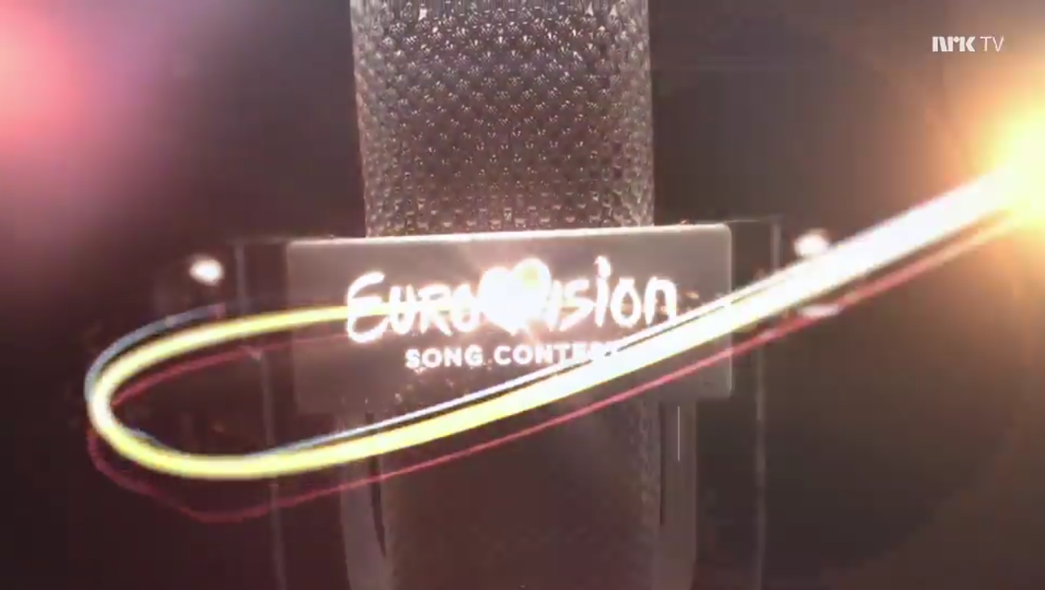

ONE THING?
OR TWO?

Slide 152
CHANGE
( WHEN DO TWO THINGS BECOME DISTINCT? )
( WHEN HAS ONE THING BECOME ANOTHER? )

Slide 153
CATEGORY
( WHICH CATEGORY DOES A THING BELONG TO? )
( CAN A THING CHANGE CATEGORY? )
( IS IT THE SAME THING IF IT CHANGES CATEGORY? )

Slide 154
RECOMMENDED READING WOMEN, FIRE AND DANGEROUS THINGS GEORGE LAKOFF

Slide 155
THE CLASSICAL THEORY OF CATEGORIZATION IS BASED ON PROPERTIES

Slide 156
CLASSES IN PROGRAMMING LANGUAGES LIKE SIMULA AND C#

Slide 157
NECESSARY AND SUFFICIENT PROPERTIES DETERMINE CATEGORY MEMBERSHIP

Slide 158
WHAT DOES A BIRD LOOK LIKE?

Slide 159
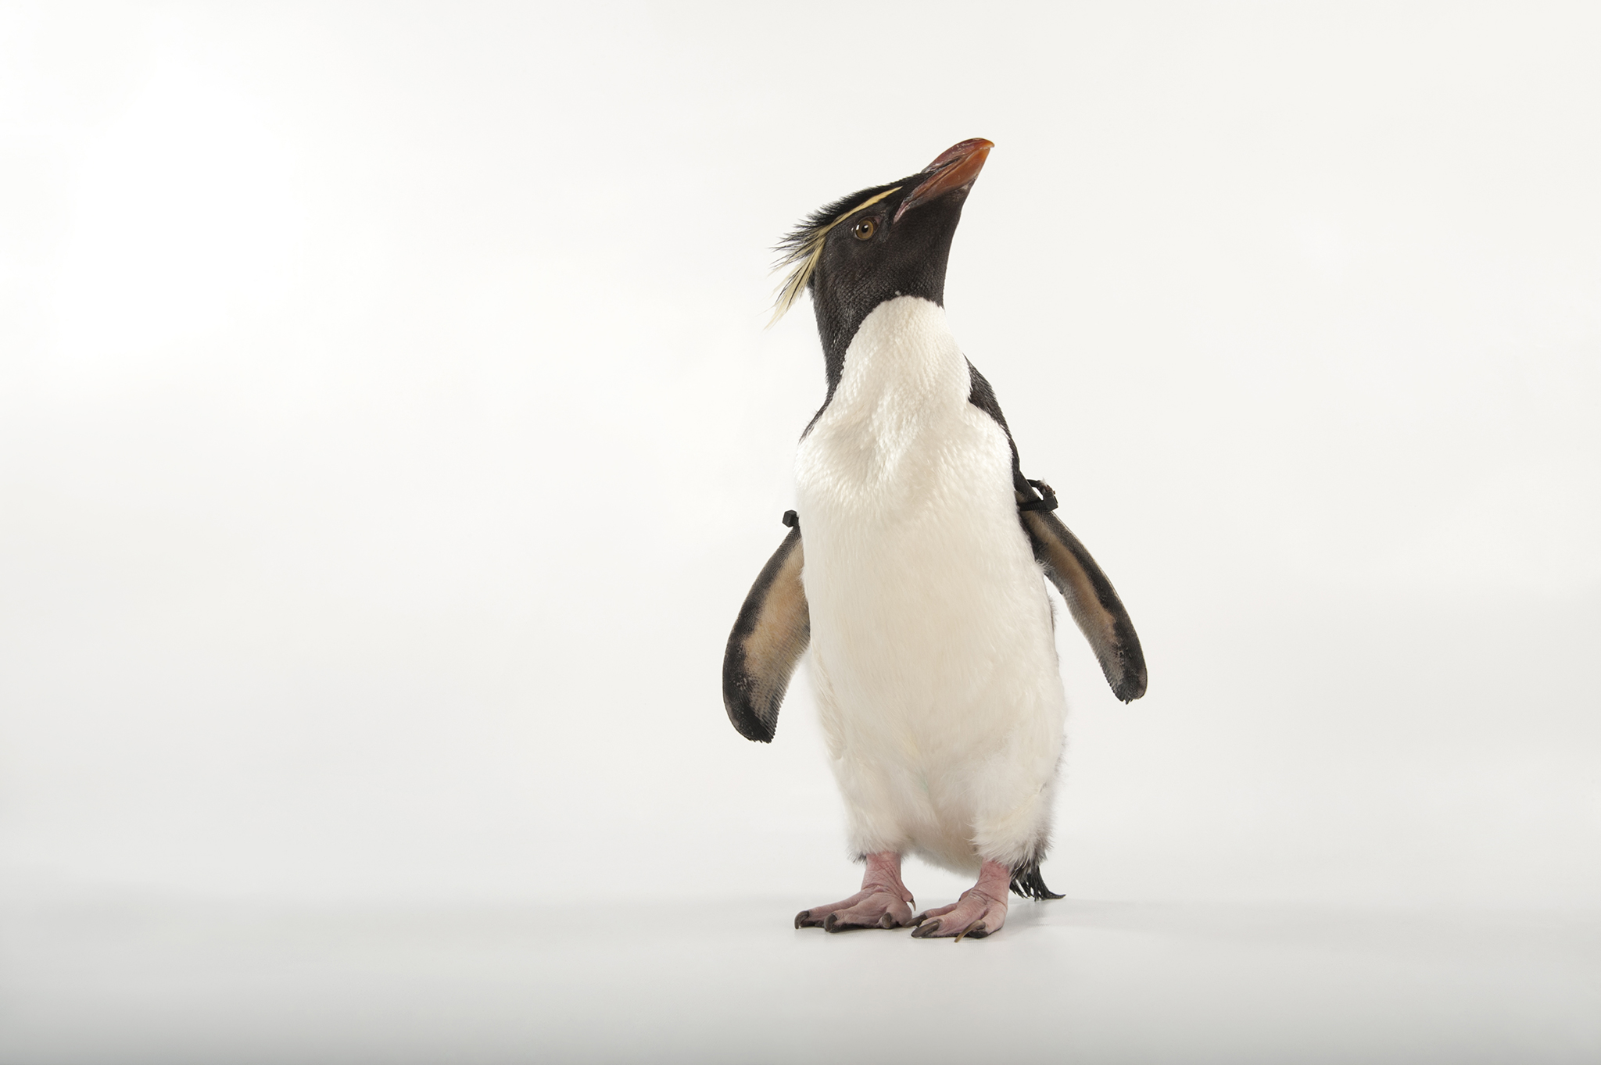

Slide 160
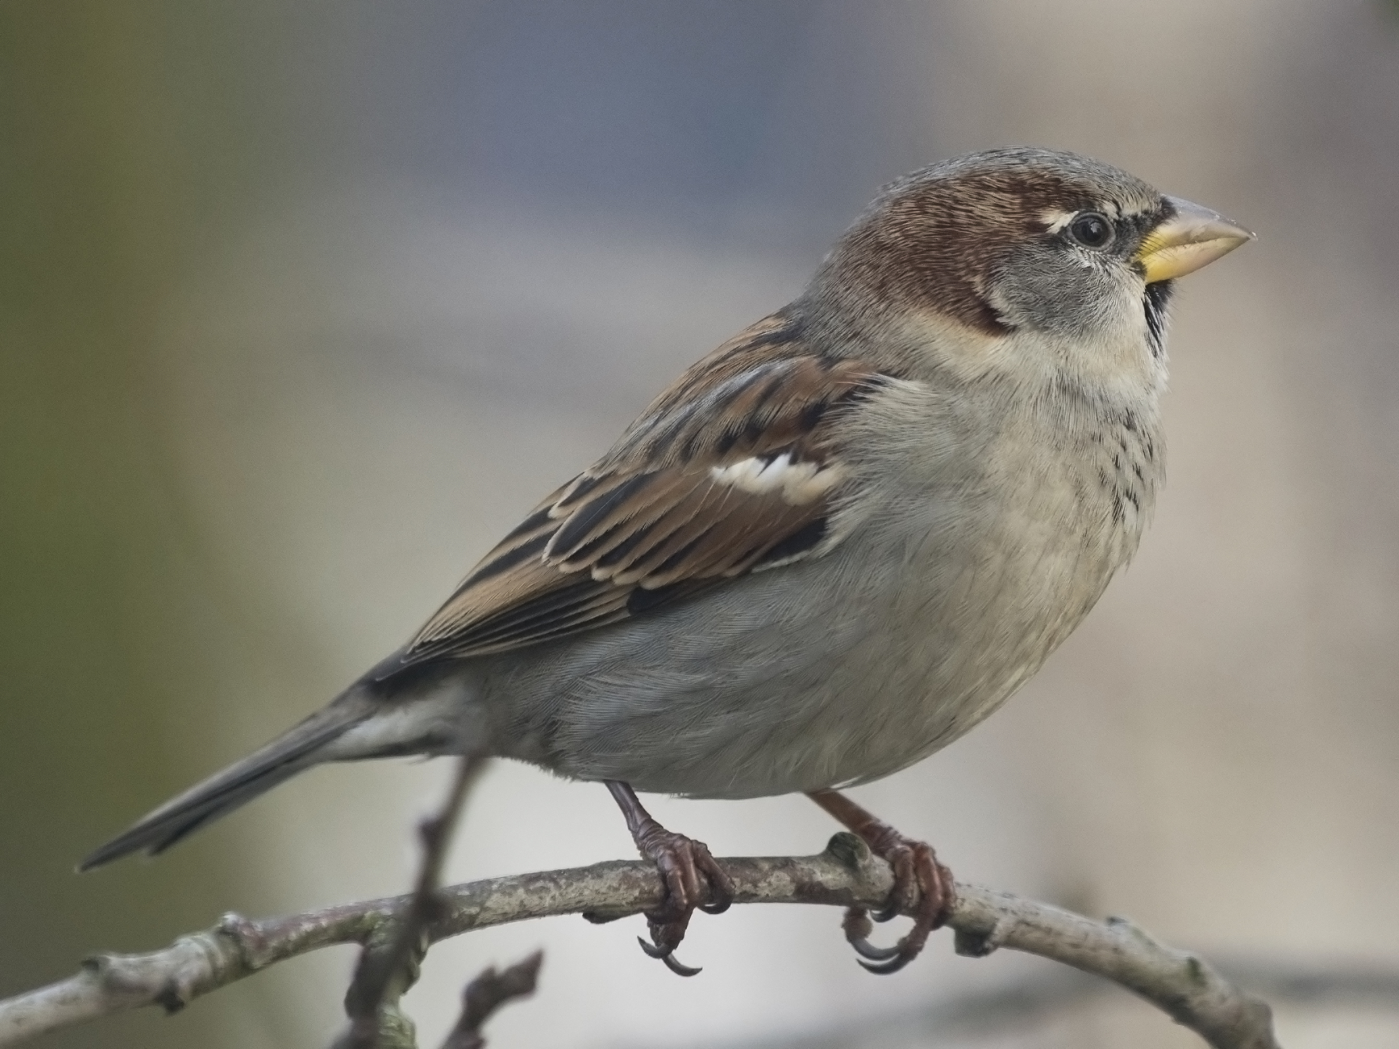

Slide 161
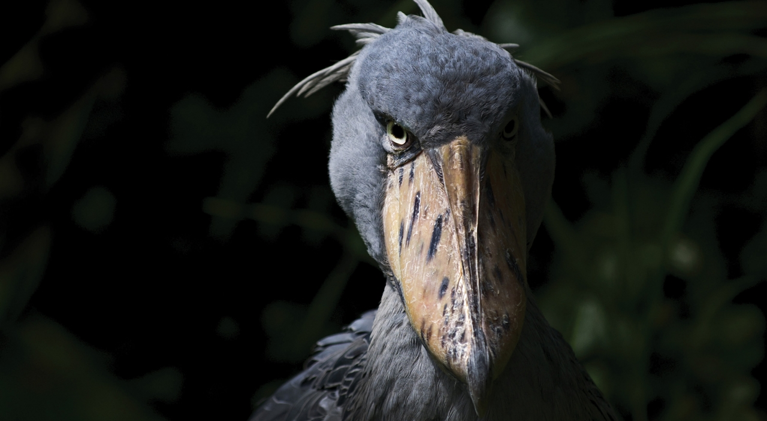

Slide 162
SOME MEMBERS OF A CATEGORY ARE MORE TYPICAL THAN OTHERS

Slide 163
A SPARROW IS MORE BIRDY THAN A PENGUIN

Slide 164
A SPARROW IS MORE BIRDY THAN A SHOEBILL

Slide 165
A SPARROW IS PROBABLY THE BIRDIEST BIRD THERE IS

Slide 166
PROPERTY-BASED CLASSIFICATION IS LIMITED

Slide 167
STRIPES DO NOT A ZEBRA MAKE

Slide 168
ELEANOR ROSCH PROTOTYPE THEORY

Slide 169
HOW UNTYPICAL IS TOO UNTYPICAL?

Slide 170
HOW UNEQUAL IS TOO UNEQUAL?

Slide 171
WHEN DOES A DONKEY BECOME A DONKEY?

Slide 172
IT DEPENDS!

Slide 173
WHO’S ASKING?

Slide 174
WHO’S ANSWERING?

Slide 175
THE DONKEY DOESN’T CARE!

Slide 176
A DONKEY BY ANY OTHER NAME WOULD SMELL THE SAME

Slide 177
WE PUT THINGS IN CATEGORIES TO MAKE SENSE OF REALITY

Slide 178
GENERALIZATION IS A HYPOTHESIS ABOUT THE FUTURE

Slide 179
BEWARE ARTIFICIAL AD-HOC GENERALIZATIONS!

Slide 180
I DO NOT BELIEVE THAT NATURE FRUSTRATES US BY DESIGN, BUT I REJOICE IN HER INTRANSIGENCE NONETHELESS. — sj gould

Slide 181
WHY MODELLING IS HARD #2
THOSE DOING THE MODELLING

Slide 182
WHO MAKES SOFTWARE?

Slide 183
WHO OWNS TECHNICAL DEBT?

Slide 184
THE REST OF THE ORGANIZATION WOULD LOVE FOR TECHNICAL DEBT TO BE THE PROBLEM OF THE IT DEPARTMENT

Slide 185
IF YOU REMAKE AWFUL SOFTWARE FROM SCRATCH WITHOUT CHANGING THE CULTURE THAT CREATED IT YOU’LL REMAKE AWFUL SOFTWARE. — @MALK_ZAMETH

Slide 186
RECOMMENDED READING HOW DO COMMITTEES INVENT? MEL CONWAY

Slide 187
CONWAY’S HOMOMORPHISM

Slide 188
AN ORGANIZATION TENDS TO PRODUCE SELF-PORTRAITS IN THE SYSTEMS IT CREATES

Slide 189
INVERSE CONWAY MANEUVER REORGANIZE TO ENABLE ARCHITECTURAL CHANGE

Slide 190
SYSTEMS ARE ORGANIZATIONAL CONCRETE

Slide 191
COROLLARY TO CONWAY’S LAW: IF YOU DESIGN A SYSTEM, BUT YOU DIDN’T DESIGN THE ORGANIZATION STRUCTURE, YOU’RE NOT THE SYSTEM’S DESIGNER. — @MATHIASVERRAES

Slide 192
THE DIVIDE BETWEEN BUSINESS AND IT IS PROBLEMATIC

Slide 193
SYSTEM ARCHITECTURE IS ENTERPRISE ARCHITECTURE AND VICE VERSA

Slide 195
WE HAVE COME A LONG WAY FROM UGLY CODE!

Slide 196
WHY DO WE STILL TALK ABOUT TECHNICAL DEBT?

Slide 197
THE CONSEQUENCES ARE MADE MANIFEST AND VISIBLE AT THE TECHNICAL LEVEL

Slide 198
DEVELOPERS LOOK FOR TECHNICAL SOLUTIONS TO SOFT PROBLEMS

Slide 199
THE SOFT PROBLEMS ARE THE HARD PROBLEMS

Slide 200
TECHNICAL TASKS ARE TEMPTING!

Slide 201
THEY FIT OUR TRAINING AND EXPERTISE

Slide 202
THEY INVOLVE LITTLE IN TERMS OF PSYCHOLOGY AND POLITICS

Slide 203
THEY RARELY LEAD TO CONFLICT

Slide 204
TECHNICAL WORK IS PUZZLE SOLVING

Slide 205
MODELLING WORK REVEALS TENSIONS

Slide 206
YOU MAY HAVE TO REORGANIZE IN ORDER TO BE ABLE TO REFACTOR

Slide 207
WHAT MAKES A MEME SUCCESSFUL?

Slide 208
GREATEST EXPLANATION POWER?

Slide 209
MOST EFFECTIVE AT REDUCING COGNITIVE DISSONANCE?

Slide 210
THERE ARE NO TECHNICAL SOLUTIONS TO TECHNICAL DEBT

Slide 211
TECHNICAL DEBT ISN’T TECHNICAL

